Slide 1

World Energy Consumption

Slide 2

This presentation is a collaborative effort between:
Anupreet Kaur
Ashish Singh
Sirisha Tulasiram
Zara Pazouki

Slide 3
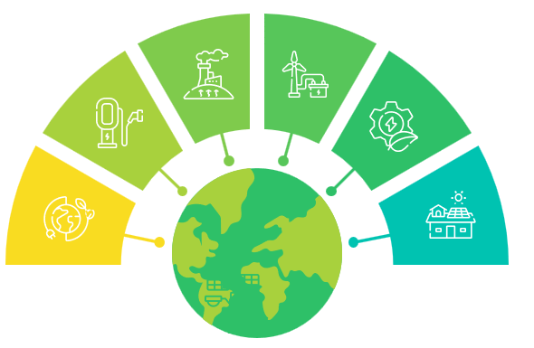
Introduction
This project explores global energy consumption trends by analyzing data across multiple energy sources.
We used various analytical and visualization techniques to uncover insights from historical data.
Data would be analyzed to check:
Trend Analysis
Resource type Pattern
Geographic Data
Global Events Impact

Slide 4
Data Sources and Methodology:
The project revolves around a detailed dataset, containing energy statistics for multiple countries and regions.
Data collected from Kaggle website and big enough to consider reliable. (more than 20000 rows and 129 columns)
Ethical considerations were observed, ensuring the use of non-sensitive data and promoting sustainability.
The dataset captures key indicators such as:
Energy production and consumption per type (coal, oil, nuclear)
GDP, population, consumption per capita, and …

Slide 5
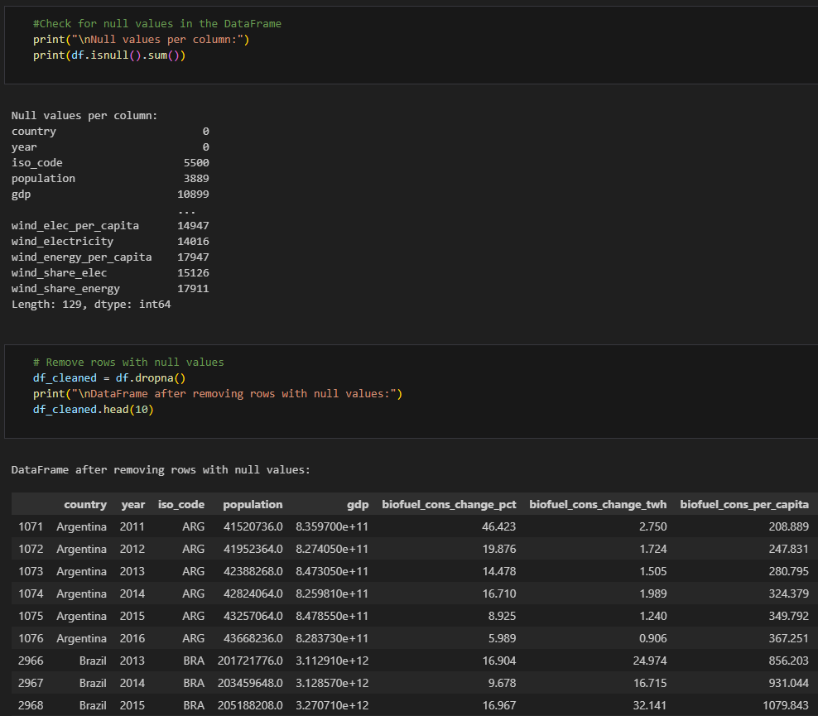





Technologies:
This project explores global energy consumption trends by analyzing data across multiple energy sources.
Our team used various analytical and visualization libraries to uncover insights from historical data.
Additionally, we employed Folium to create interactive maps, making it easier to explore consumption patterns geographically.

Slide 6








We explored data from:
gas, coal, oil,
biofuel, electricity, wind,
solar, hydro, and nuclear sources.

Slide 7
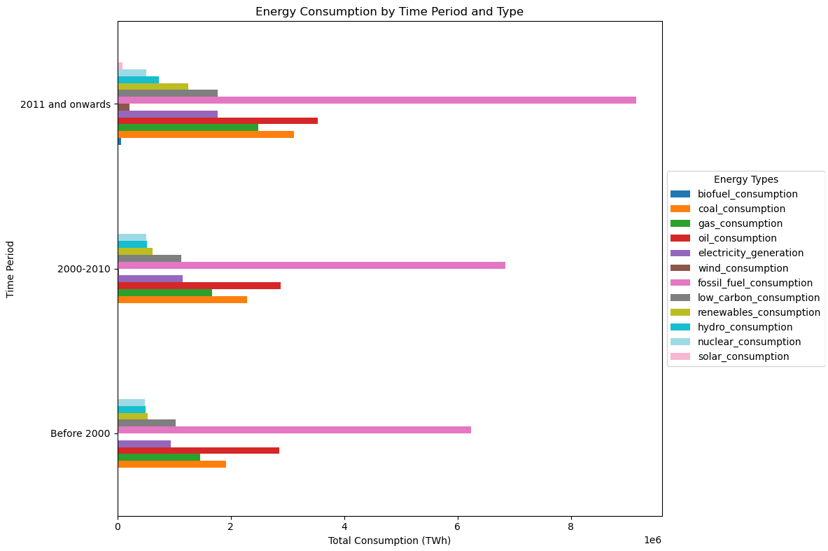
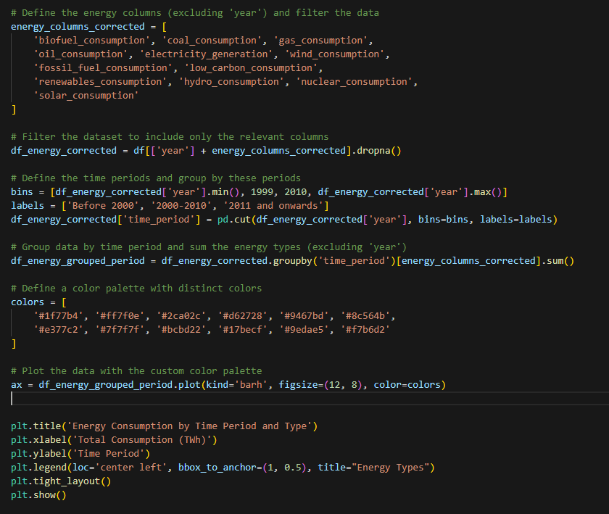
Energy Consumption by Time Period and Type

Slide 8
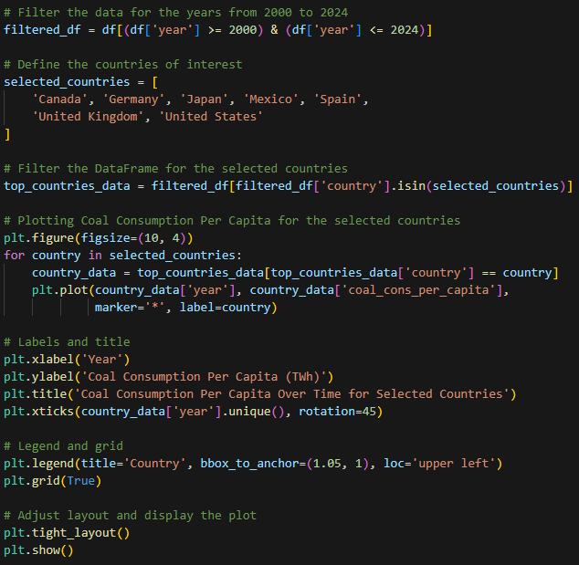
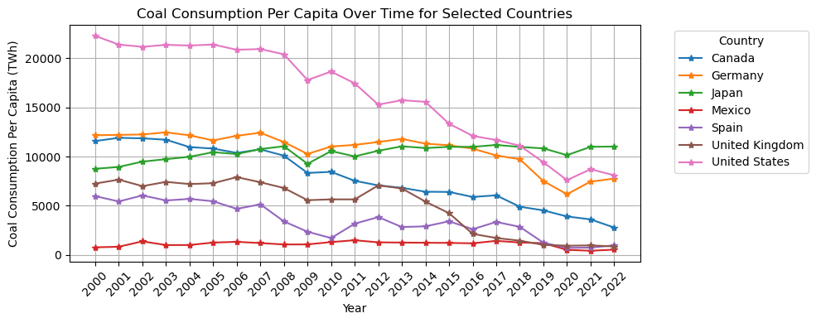

Slide 9
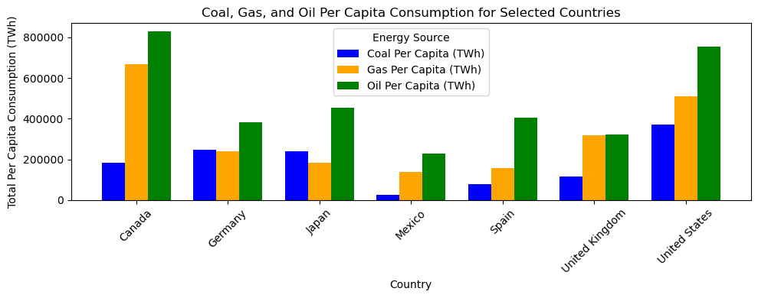
We used statistical data to highlight energy consumption across different regions and time periods. For clearer visualization, we focused on the top seven consumers for each energy source.

Slide 10
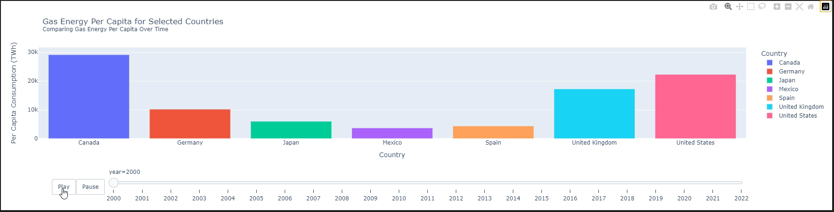
Moving forward, we plan to introduce features such as time sliders and geographical maps to enhance the exploration of energy consumption data.
Here is the Gas consumption per capita, through an animated Bar chart

Slide 11
Moving forward, we plan to introduce features such as time sliders and geographical maps to enhance the exploration of energy consumption data.
USA
Coal Consumption: 8103.174 TWh
Gas Consumption: 26049.031 TWh
Oil Consumption: 29683.652 TWh
Japan
Coal Consumption: 11016.588 TWh
Gas Consumption: 8107.861 TWh
Oil Consumption: 14811.619 TWh
Mexico
Germany
Coal Consumption: 547.351 TWh
Gas Consumption: 7575.104 TWh
Oil Consumption: 8971.466 TWh
Coal Consumption: 7763.265 TWh
Gas Consumption: 9270.737 TWh
Oil Consumption: 14191.266 TWh

Slide 12
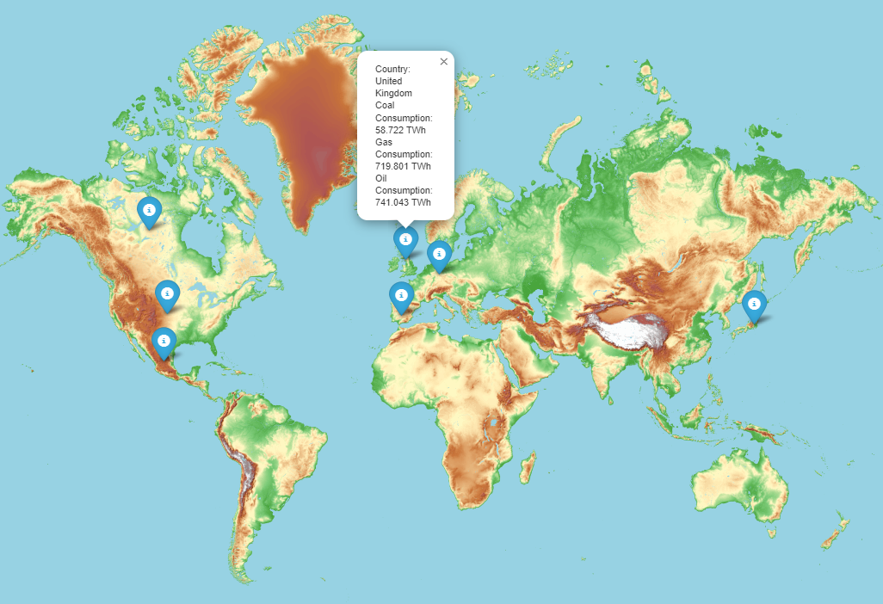

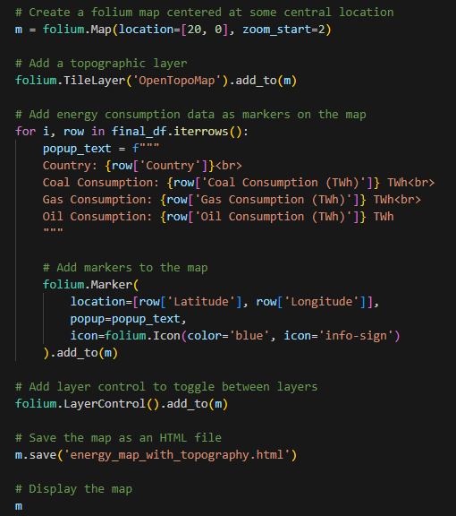

Slide 13
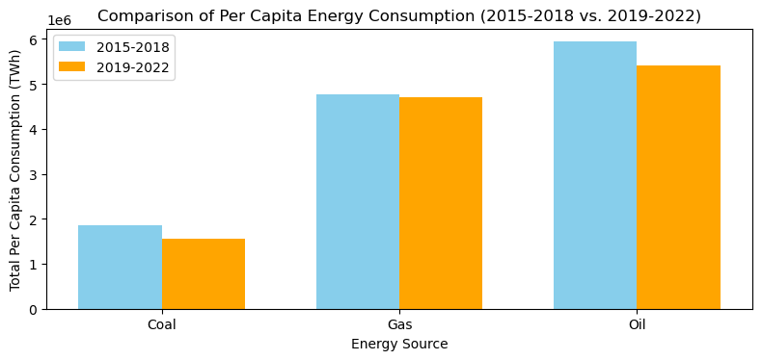
Global Events Impact
We aim to assess whether global issues impact energy consumption trends. For this analysis, we focused on a recent event: the COVID-19 pandemic.

Slide 14
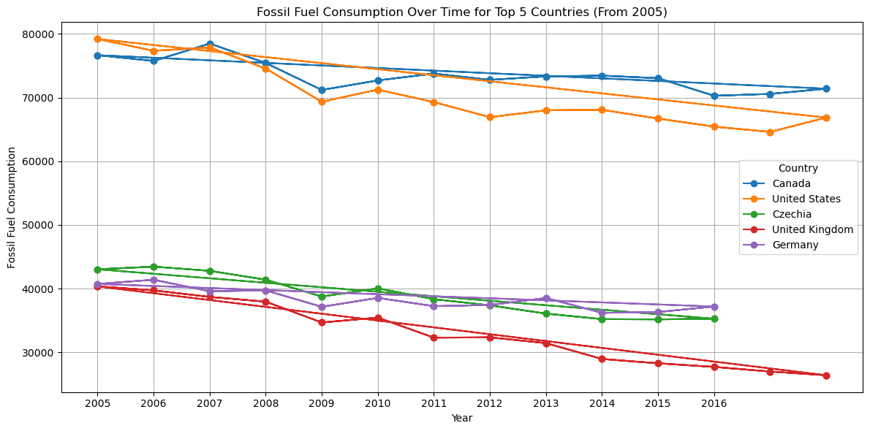
Fossil Fuel Consumption
While studying the trends of consumption of Fossil Fuel Energy, we can see Canada stands out as one of the highest consumers of fossil fuel energy, reflecting its significant reliance on these resources for economic growth and energy production.

Slide 15
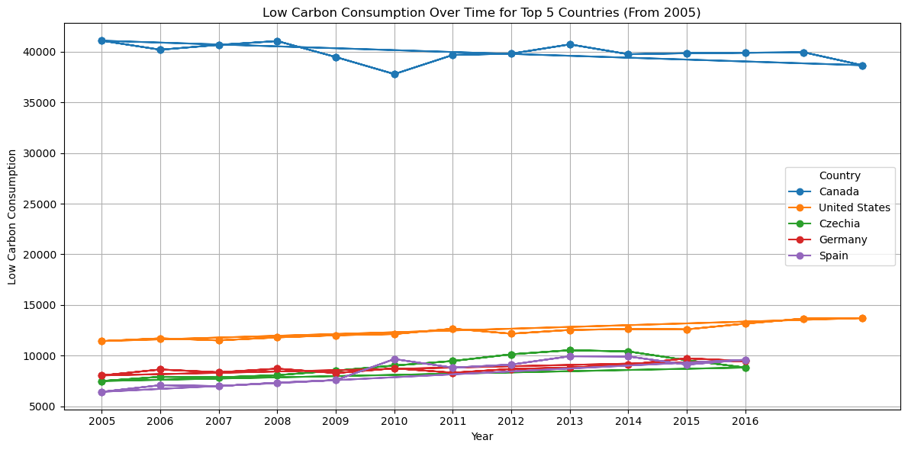
Low-Carbon Consumption
Canada is notable for being one of the highest consumers of low carbon energy, showcasing a strong commitment to transitioning towards sustainable energy sources. This trend not only reflects the country's environmental priorities but also positions Canada as a leader in the global effort to reduce carbon emissions and combat climate change.

Slide 16
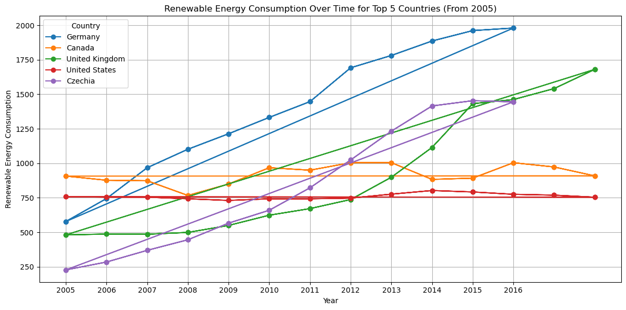
Renewable energy Consumption
Germany is recognized as one of the highest consumers of renewable energy, demonstrating a robust commitment to sustainable energy practices. This significant investment in renewables not only supports the country’s climate goals but also sets a global example for transitioning to a cleaner, more sustainable energy future. Notably, Canada ranks fourth in renewable energy consumption, reflecting its own dedication to harnessing clean energy sources and reducing greenhouse gas emissions.

Slide 17
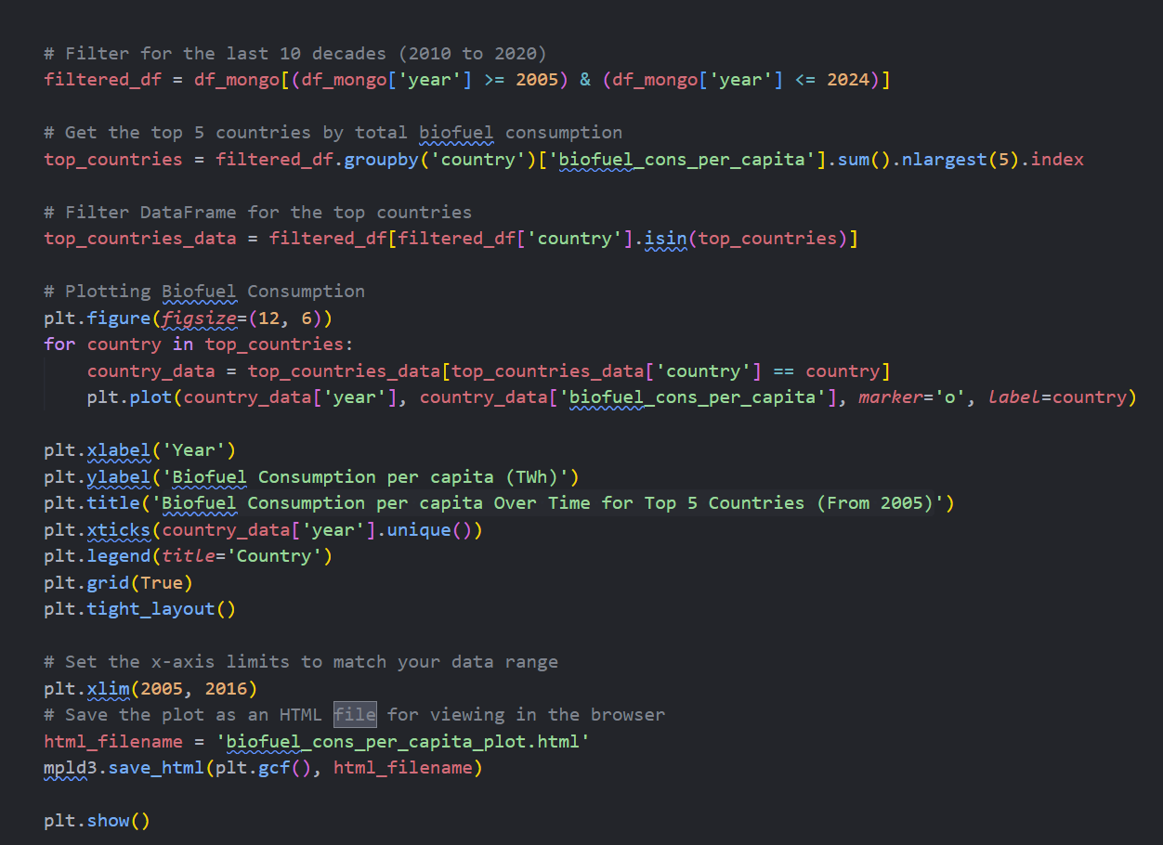
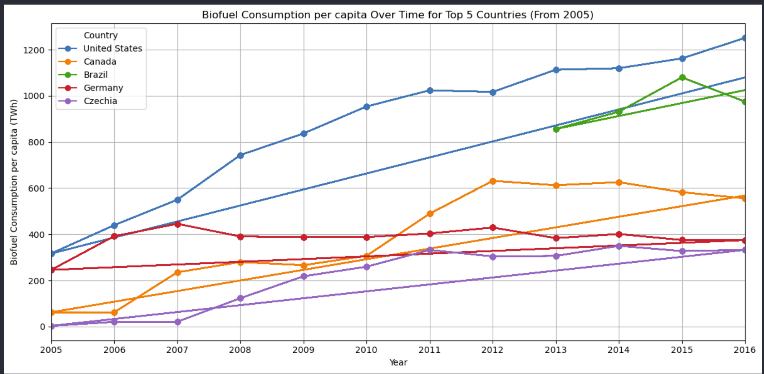
Biofuel Consumption Per Capita Over Time for Top 5 Countries (From 2005)

Slide 18
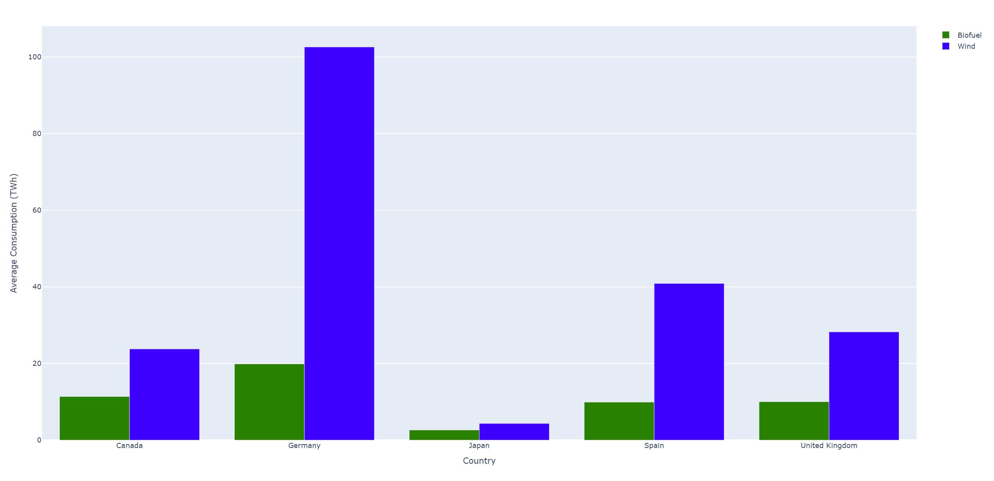
Average Biofuel and Wind Consumption for Selected Countries

Slide 19
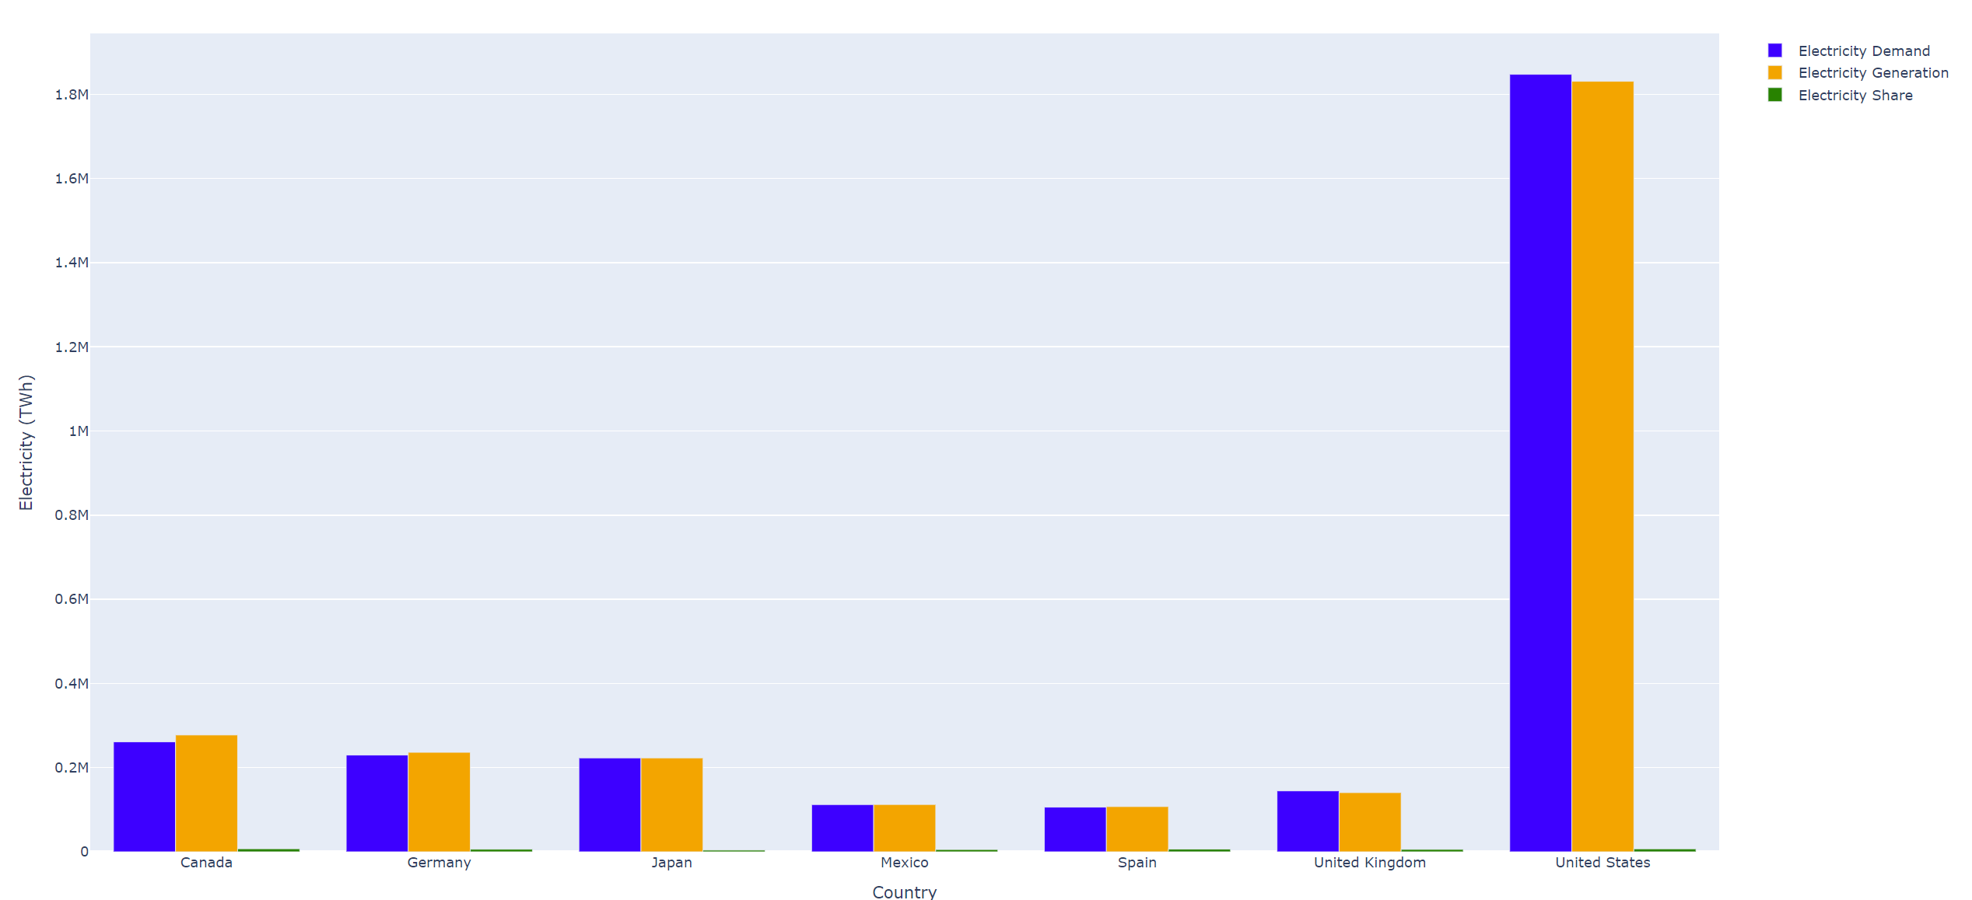
Comparison of Electricity Demand, Generation, and Share of Total Energy by Country

Slide 20
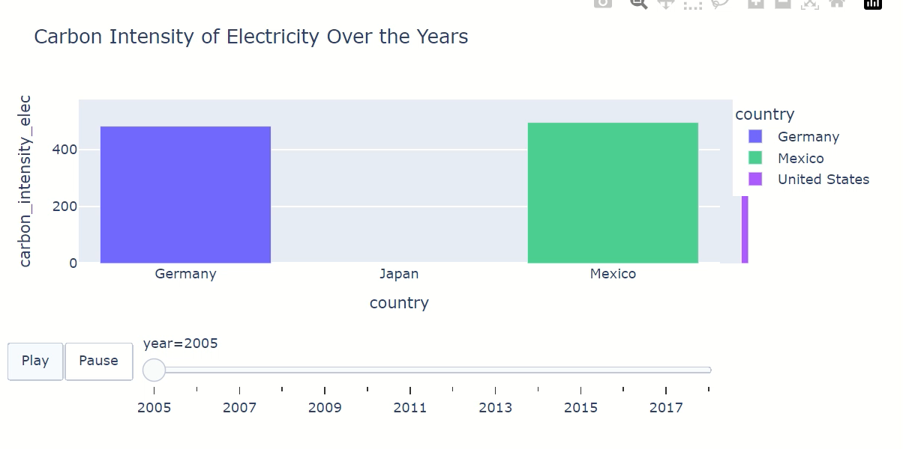
Here is the carbon intensity of electricity over the years , through an animated Bar chart

Slide 21
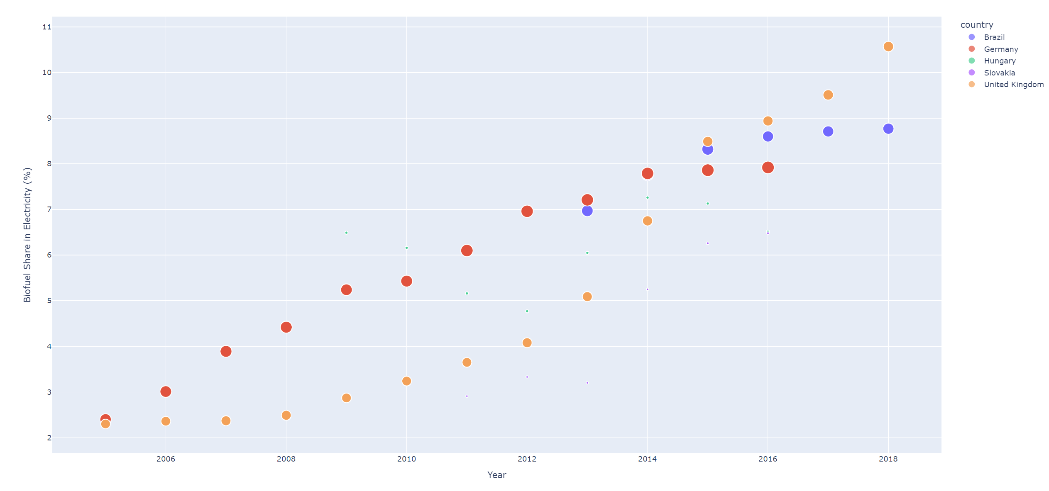
Biofuel Share of Electricity Over Time Top 5 Countries

Slide 22
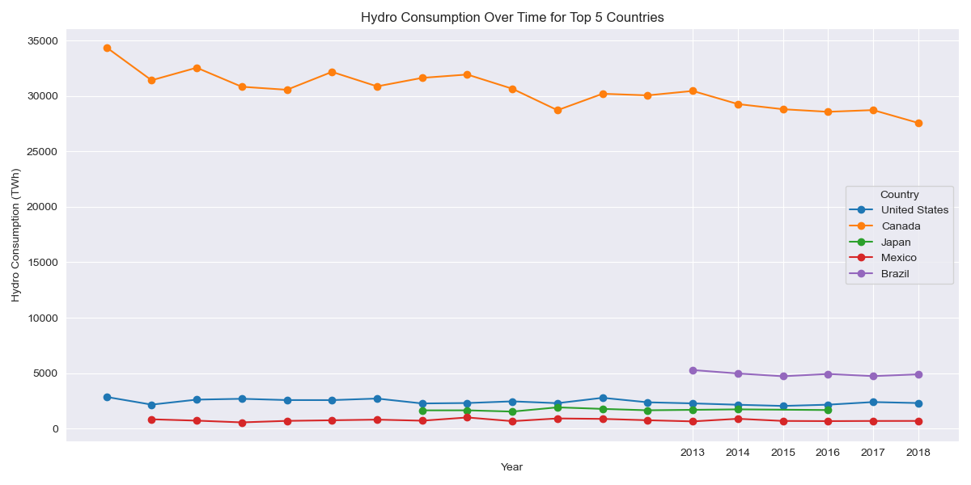
Usage of Hydro Consumption per capita
It’s quite apparent that we are the highest consumer of hydro energy and we have a good reason for it!
(Hint: It is likely that this has been our weekend plan when we have had nothing to do!)

Slide 23
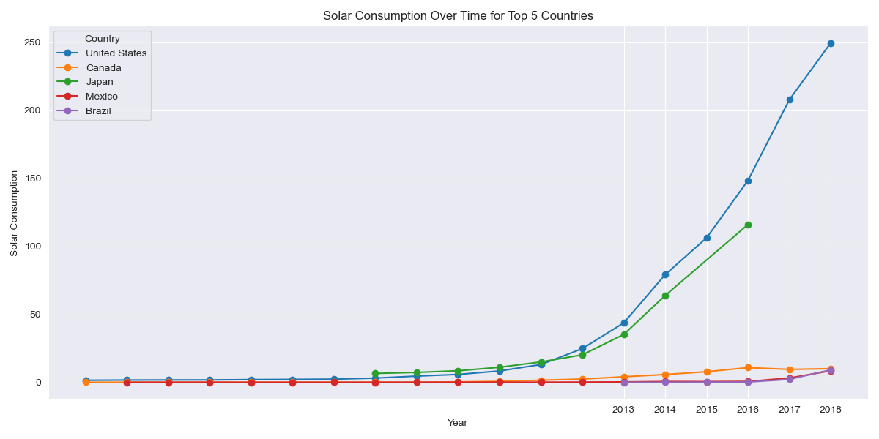
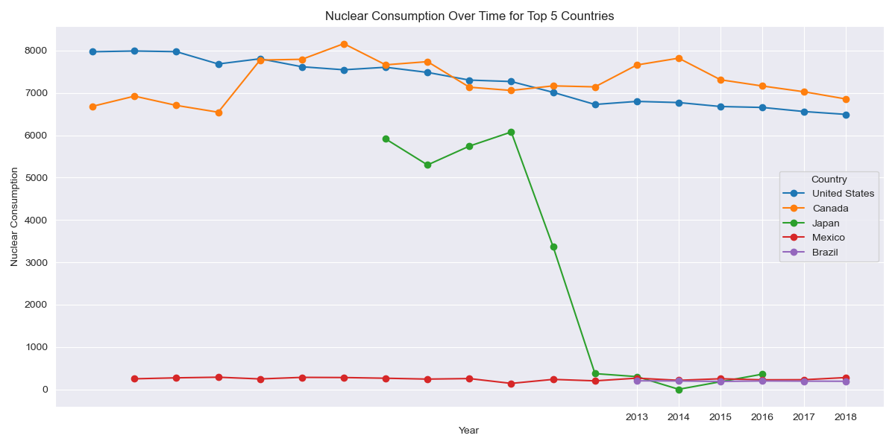
Usage of Solar and Nuclear Consumption per capita
Most of the solar power generating potential in Canada is located in the south in Alberta, Saskatchewan, and Ontario.
Canada produced 7.4 kilo tonnes of uranium in 2022 from mines in Saskatchewan

Slide 24
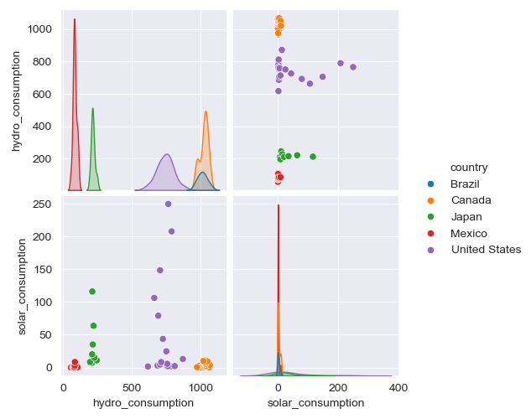
Comparing Hydro and solar
In the bottom-left plot, which shows hydro consumption vs. solar consumption, the United States (purple) stands out with both high solar and hydro consumption.
In the top-right plot, solar consumption is on the x-axis, and hydro consumption is on the y-axis.

Slide 25
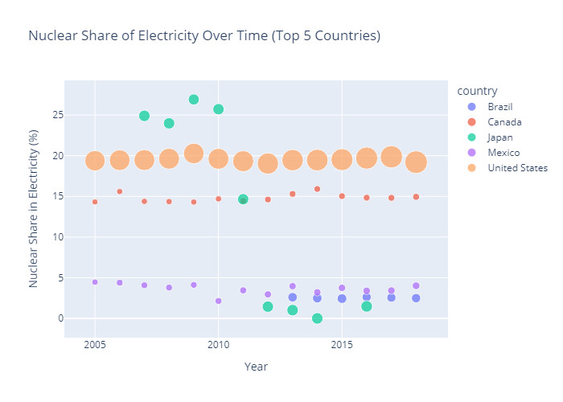
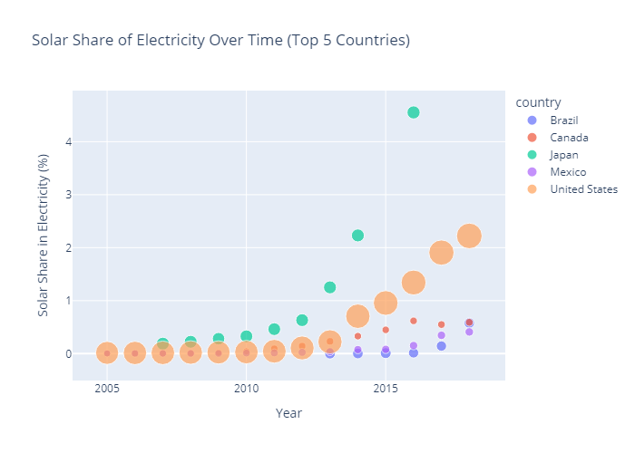
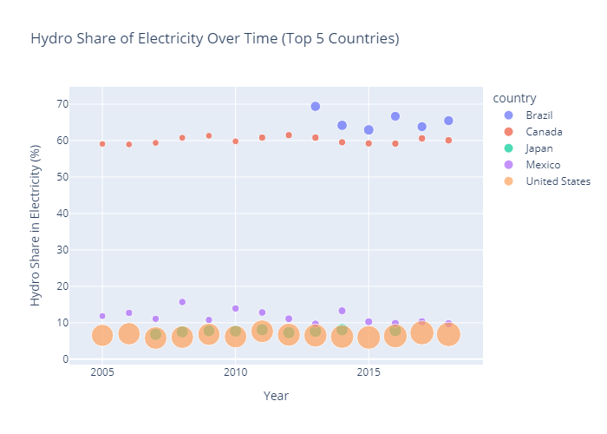
Energy share in Electricity

Slide 26

Any Questions

Slide 27
Thank You!

